Slide 1
State of the Suburban and Downtown Office Markets
Thomas I. Volini
Executive Vice President | Chicago
Colliers International

Slide 2
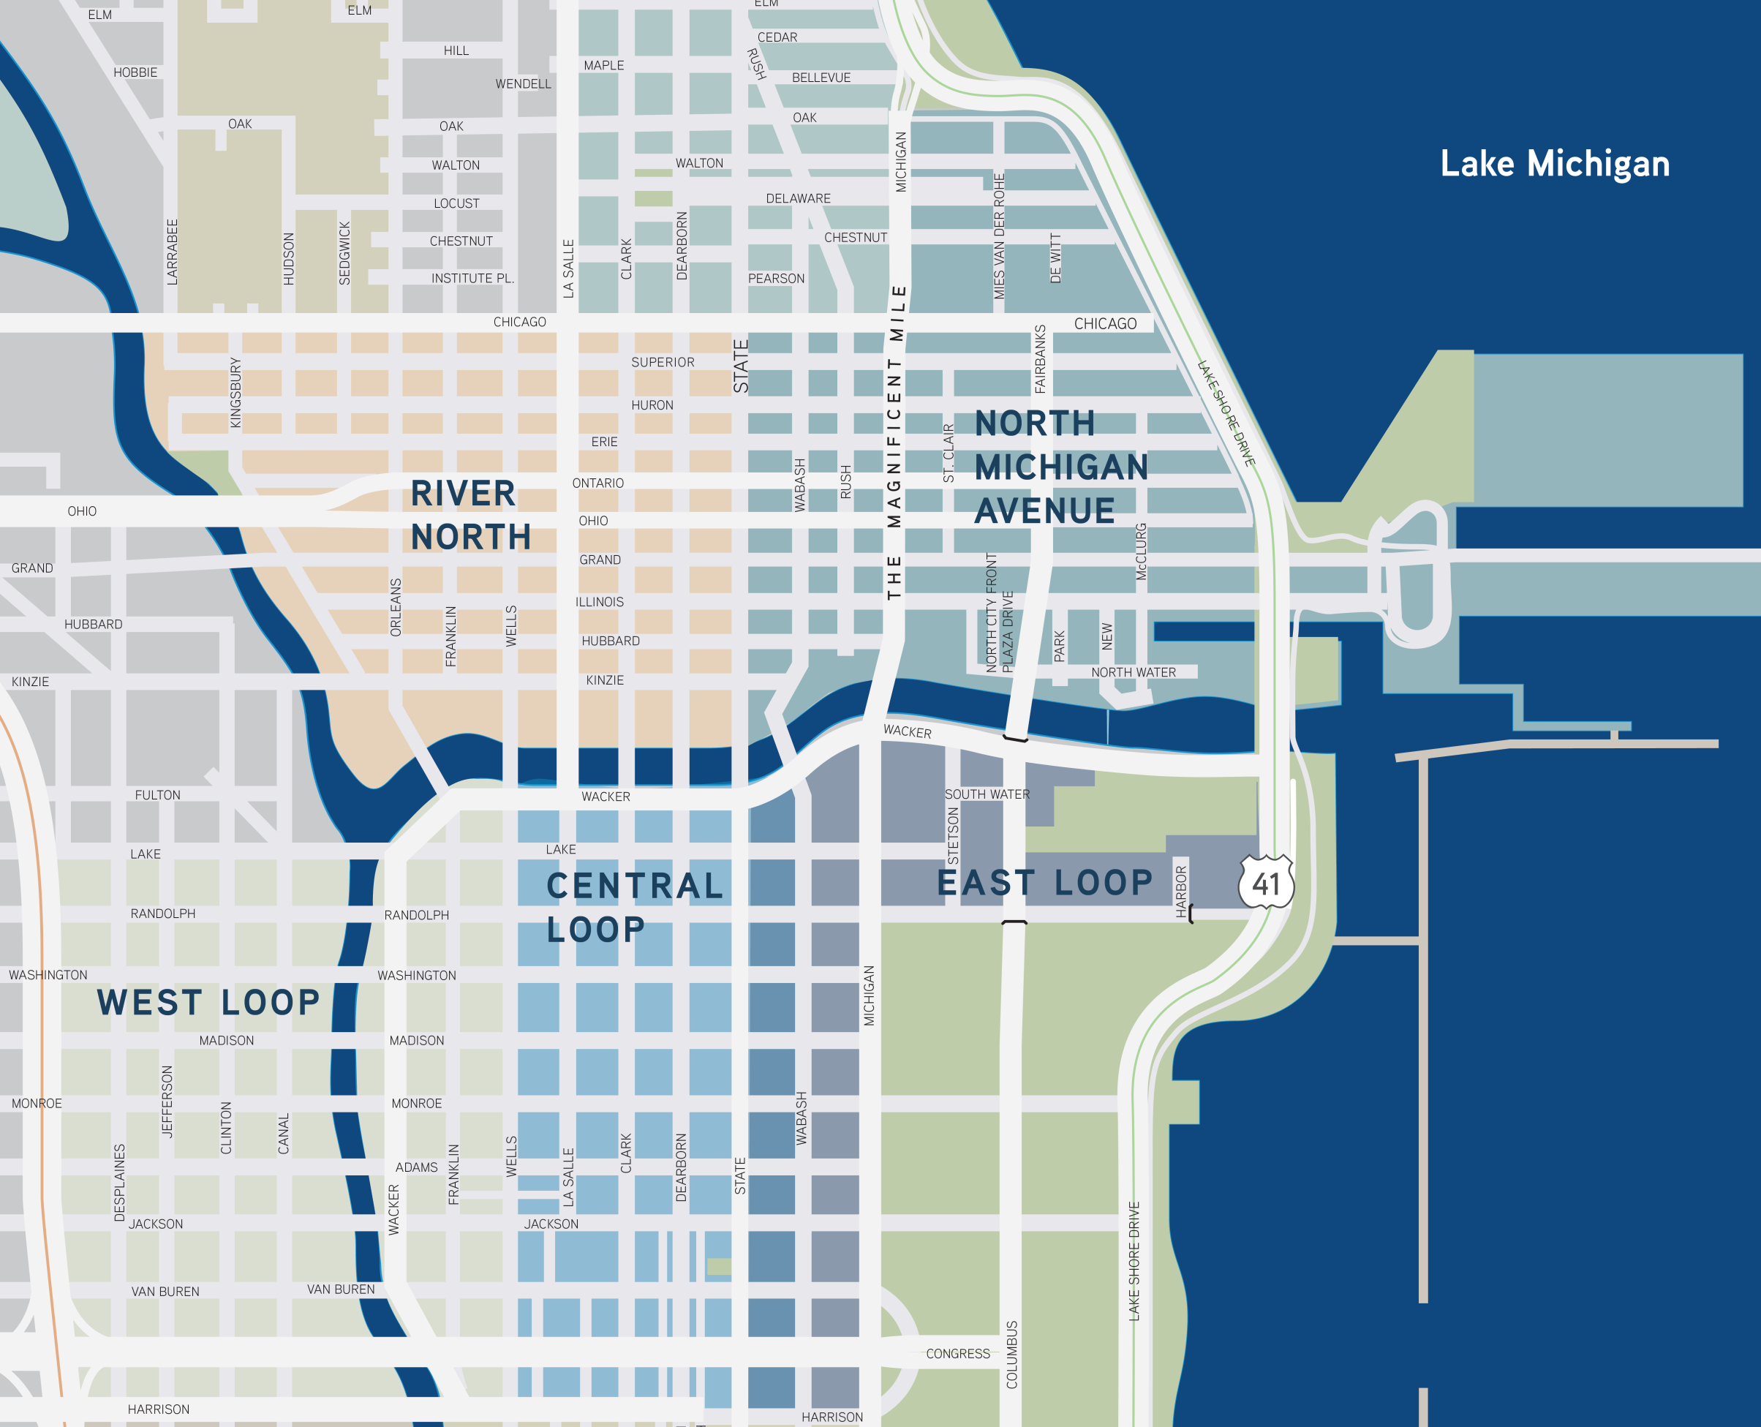
Chicago CBD: Vacancy Rates
Submarket Boundaries
Central Loop
(N) Chicago River
(S) Van Buren
(E) State Street
(W) Wells Street
East Loop
(N) Chicago River
(S) Van Buren Street
(E) Lake Michigan
(W) State Street
North Michigan Avenue
(N) Oak Street
(S) Chicago River
(E) Lake Michigan
(W) State Street
River North
(N) Oak Street
(S) Chicago River
(E) State Street
(W) Chicago River
West Loop
(N) Kinzie Street
(S) Van Buren Street
(E) Wells Street
(W) Halsted Street
Fulton Market
(N) Grand Avenue
(S) Washington Boulevard
(E) Halsted Street
(W) Ashland Avenue
OVERALL CBD
MARKET INDICATORS | CURRENT Q3 2017
VACANCY | 12.7%
QTR ABSORPTION | 245,552
YTD ABSORPTION | 275,814
RENTAL RATE | $39.22
RIVER NORTH
MARKET INDICATORS | CURRENT Q3 2017
VACANCY | 9.7%
QTR ABSORPTION | 51,061
YTD ABSORPTION | -53,281
RENTAL RATE | $41.83
NORTH MICHIGAN AVENUE
MARKET INDICATORS | CURRENT Q3 2017
VACANCY | 7.5%
QTR ABSORPTION | 7,671
YTD ABSORPTION | 223,503
RENTAL RATE | $36.17
WEST LOOP
MARKET INDICATORS | CURRENT Q3 2017
VACANCY | 14.1%
QTR ABSORPTION | 282,342
YTD ABSORPTION | 833,206
RENTAL RATE | $42.69
EAST LOOP
MARKET INDICATORS | CURRENT Q3 2017
VACANCY | 12.9%
QTR ABSORPTION | 29,244
YTD ABSORPTION | -80,577
RENTAL RATE | $34.90
CENTRAL LOOP
MARKET INDICATORS | CURRENT Q3 2017
VACANCY | 13.2%
QTR ABSORPTION | -170,945
YTD ABSORPTION | -739,470
RENTAL RATE | $37.56

Slide 3
Chicago CBD: Existing Situation
Rental Rates
New Construction (Class A/Trophy) $60-65 per RSF
Built in the 2000’s (Class A)
$50-55 per RSF
80’s and 90’s Construction (Class A)
$40-45 per RSF
70’s Construction (Class B)
$35-40 per RSF
Art Deco Rehabbed (LaSalle Street, Civic Opera)
$30-35 per RSF
OVERALL CBD
MARKET INDICATORS | CURRENT Q3 2017
VACANCY | 12.7%
QTR ABSORPTION | 245,552
YTD ABSORPTION | 275,814
RENTAL RATE | $39.22
RIVER NORTH
MARKET INDICATORS | CURRENT Q3 2017
VACANCY | 9.7%
QTR ABSORPTION | 51,061
YTD ABSORPTION | -53,281
RENTAL RATE | $41.83
NORTH MICHIGAN AVENUE
MARKET INDICATORS | CURRENT Q3 2017
VACANCY | 7.5%
QTR ABSORPTION | 7,671
YTD ABSORPTION | 223,503
RENTAL RATE | $36.17
WEST LOOP
MARKET INDICATORS | CURRENT Q3 2017
VACANCY | 14.1%
QTR ABSORPTION | 282,342
YTD ABSORPTION | 833,206
RENTAL RATE | $42.69
EAST LOOP
MARKET INDICATORS | CURRENT Q3 2017
VACANCY | 12.9%
QTR ABSORPTION | 29,244
YTD ABSORPTION | -80,577
RENTAL RATE | $34.90
CENTRAL LOOP
MARKET INDICATORS | CURRENT Q3 2017
VACANCY | 13.2%
QTR ABSORPTION | -170,945
YTD ABSORPTION | -739,470
RENTAL RATE | $37.56

Slide 4
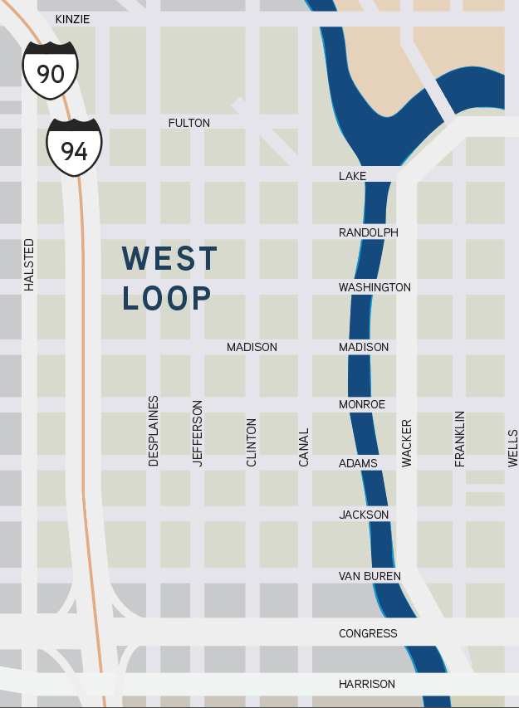
Chicago CBD: New Construction
1
444 W. LAKE (River Point)
1,081,702 SF
Completion:
December 2016
Developer: Ivanhoe Cambridge/ Hines/Levy Joint Venture
Stories: 52
Asking Net Rents:
$35.00-$46.00/SF
Anchor Tenants:
McDermott Will & Emery: 206,000 SF
DLA Piper: 152,000 SF
Mead Johnson: 78,000 SF
Morton Salt: 53,000 SF
2
1
3
6
4
5

Slide 5
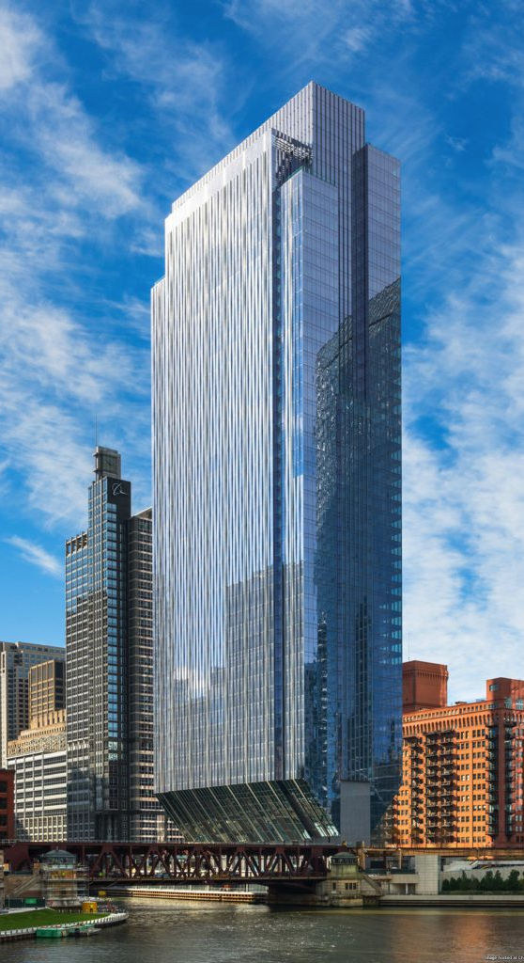
Chicago CBD: New Construction
2
150 N. RIVERSIDE
1,284,404 SF
Completion:
February 2017
Developer:
Riverside Investments (J. O’Donnell)
Stories: 54
Asking Net Rents:
$33.00-$40.00/SF
Anchor Tenants:
William Blair: 347,000 SF
Hyatt Hotels Corp: 271,000 SF
Polsinelli Law Firm: 112,000 SF
Navigant: 111,000 SF
2
1
3
6
4
5

Slide 6
Chicago CBD: New Construction
3
151 N. FRANKLIN (CNA Center)
807,000 SF
Delivery:
June 2018
Developer:
John Buck Company
Stories: 35
Asking Net Rents:
$31.00-$40.00/SF
Anchor Tenants:
CNA Insurance: 274,000 SF
Hinshaw & Culbertson: 92,000 SF
2
1
3
6
4
5

Slide 7
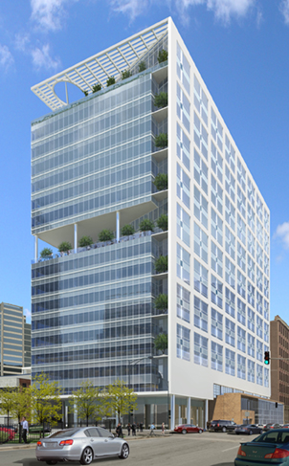
Chicago CBD: New Construction
4
625 W. ADAMS
443,645 SF
Delivery:
June 2018
Developer:
White Oak Realty & CA Ventures
Stories: 20
Asking Net Rents:
$32.00-$34.00/SF
Anchor Tenants:
None (Building Speculative)
2
1
3
6
4
5

Slide 8
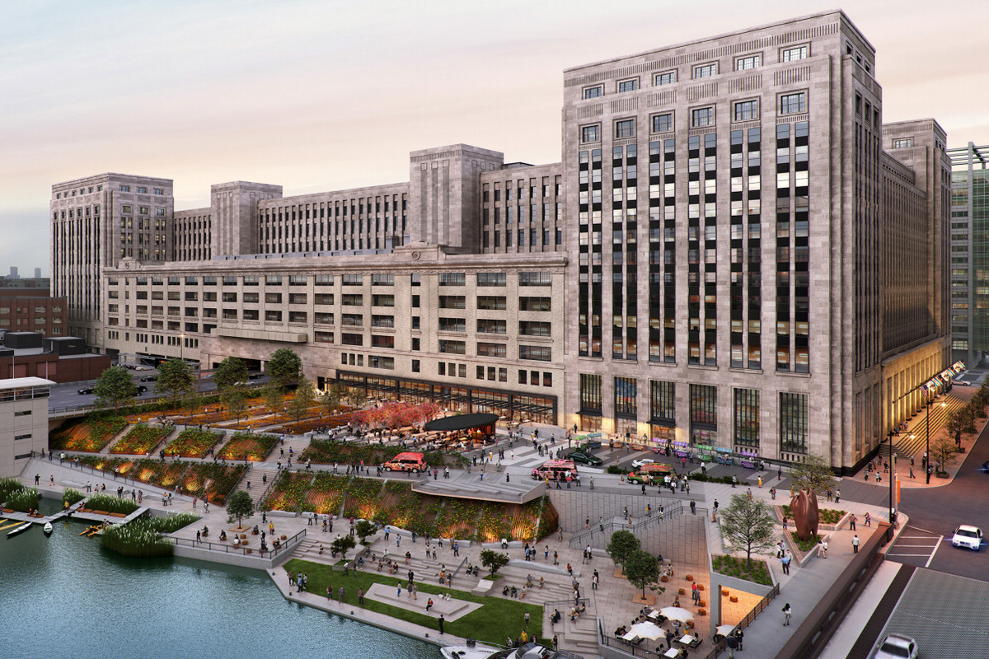
Chicago CBD: New Construction
5
2
1
3
6
4
OLD MAIN POST OFFICE (Renovation)
2,500,000 SF
Delivery:
2018/2019
Developer:
601 W Companies
Stories: 9
Asking Net Rents:
TBD
Anchor Tenants:
TBD
5

Slide 9
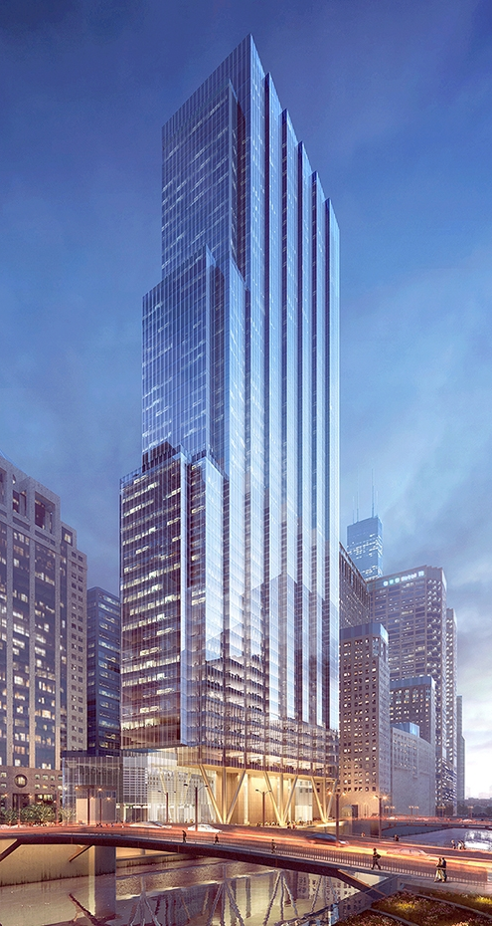
Chicago CBD: New Construction
6
110 N. WACKER (Hughes Tower)
1,350,000 SF
Delivery:
2020
Developer:
Howard Hughes Corporation & Riverside Investment & Development
Stories: 9
Asking Net Rents:
$38.50-$47.00/SF
Anchor Tenants:
Bank of America: 500,000 SF
2
1
3
6
4
5

Slide 10
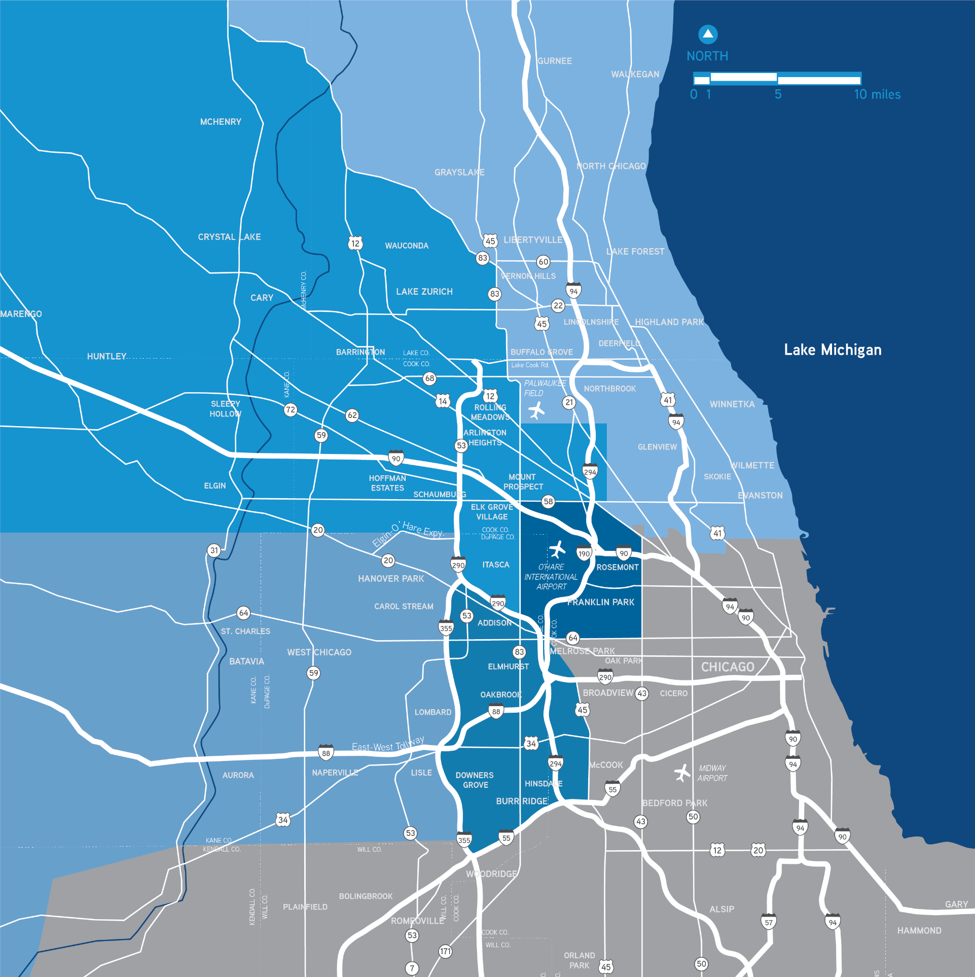
Suburban Chicago Office: Vacancy Rates
Overall Market Statistics (Q3 2017)
OVERALL MARKET
MARKET INDICATORS | CURRENT Q3 2017
VACANCY | 21.7%
YTD ABSORPTION | 193,743
RENTAL RATE | $20.60
INVENTORY | 113,371,748
3
2
Five Submarkets
O’Hare
Northwest
North
Lisle-Naperville
Oak Brook
1
1
2
4
5
3
4
5

Slide 11
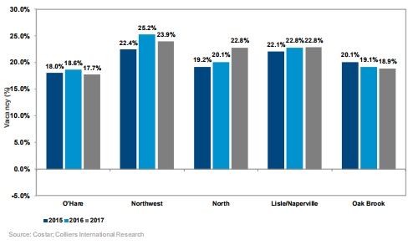
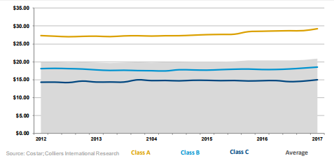
Suburban Chicago Office: Key Statistics
Suburban Vacancy Rates | 2015-2017
Asking Gross Rental Rates

Slide 12
Suburban Chicago Office: Vacancy Rates
Market Statistics by Submarket
1
O’HARE
MARKET INDICATORS | CURRENT Q3 2017
VACANCY | 17.7%
YTD ABSORPTION | 123,026
RENTAL RATE | $20.81
INVENTORY | 13,368,739
4
LISLE-NAPERVILLE
MARKET INDICATORS | CURRENT Q3 2017
VACANCY | 22.8%
YTD ABSORPTION | (7,647)
RENTAL RATE | $20.69
INVENTORY | 16,849,554
3
2
NORTHWEST
MARKET INDICATORS | CURRENT Q3 2017
VACANCY | 23.9%
YTD ABSORPTION | 400,759
RENTAL RATE | $19.02
INVENTORY | 30,681,721
5
OAK BROOK
MARKET INDICATORS | CURRENT Q3 2017
VACANCY | 18.9%
YTD ABSORPTION | 65,051
RENTAL RATE | $20.29
INVENTORY | 23,454,012
2
1
3
NORTH
MARKET INDICATORS | CURRENT Q3 2017
VACANCY | 22.8%
YTD ABSORPTION | (774,932)
RENTAL RATE | $22.17
INVENTORY | 29,017,722
4
5

Slide 13
Suburban Chicago Office: New Construction
Construction Update
No speculative construction since 2010 and none expected in 2017
3 ongoing build-to-suits
Ongoing Build-to-Suits
1
CENTRAL STATES FUNDS
150,000 SF
8655 W. Higgins Road
Chicago, IL
2
AMERICAN ACADEMY OF PEDIATICS
193,000 SF
Itasca, IL
3
2
1
3
MCSHANE DEVELOPMENT COMPANY / METLIFE REAL ESTATE INVESTORS’ HUNTINGTON 90
New Business Park
Hoffman Estates, IL

